Slide 1
System Modelling and Controller Design

Slide 2
Goals
Determine the systems Transfer Function
Decide on appropriate Design Targets
Design an appropriate System Controller to meet Design Targets

Slide 3
What’s A Transfer Function ?
Simply put, a mathematical function relating the output or response of a system to the input or stimulus given to the system.
In our case:
Output = Velocity of wheels
Input = PWM signal from the Arduino

Slide 4
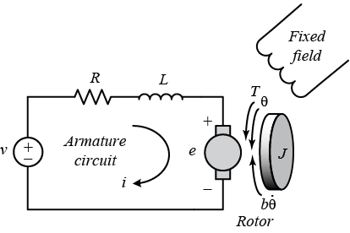
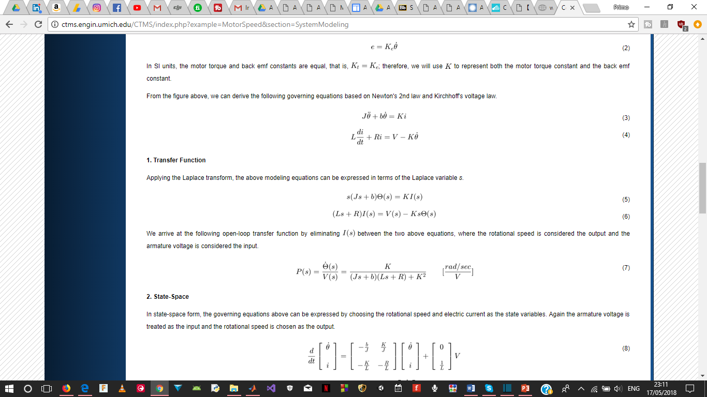
So….How Do We Get The Transfer Function?
Ideally… through some unpleasant maths….
And that’s with ignoring the chassis and the whole PWM thing ….
But I Wont Be Doing That

Slide 5
Yep….We Let It Spin!
Ask yourself this:
what IS spinning really ?
what are we trying to measure ? and
what was a transfer function again?

Slide 6
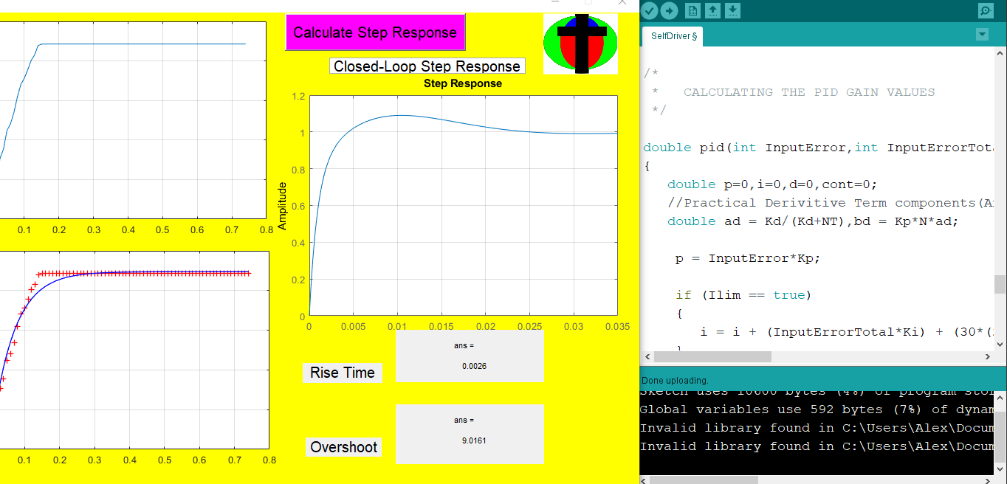
Control design and Implementation

Slide 7
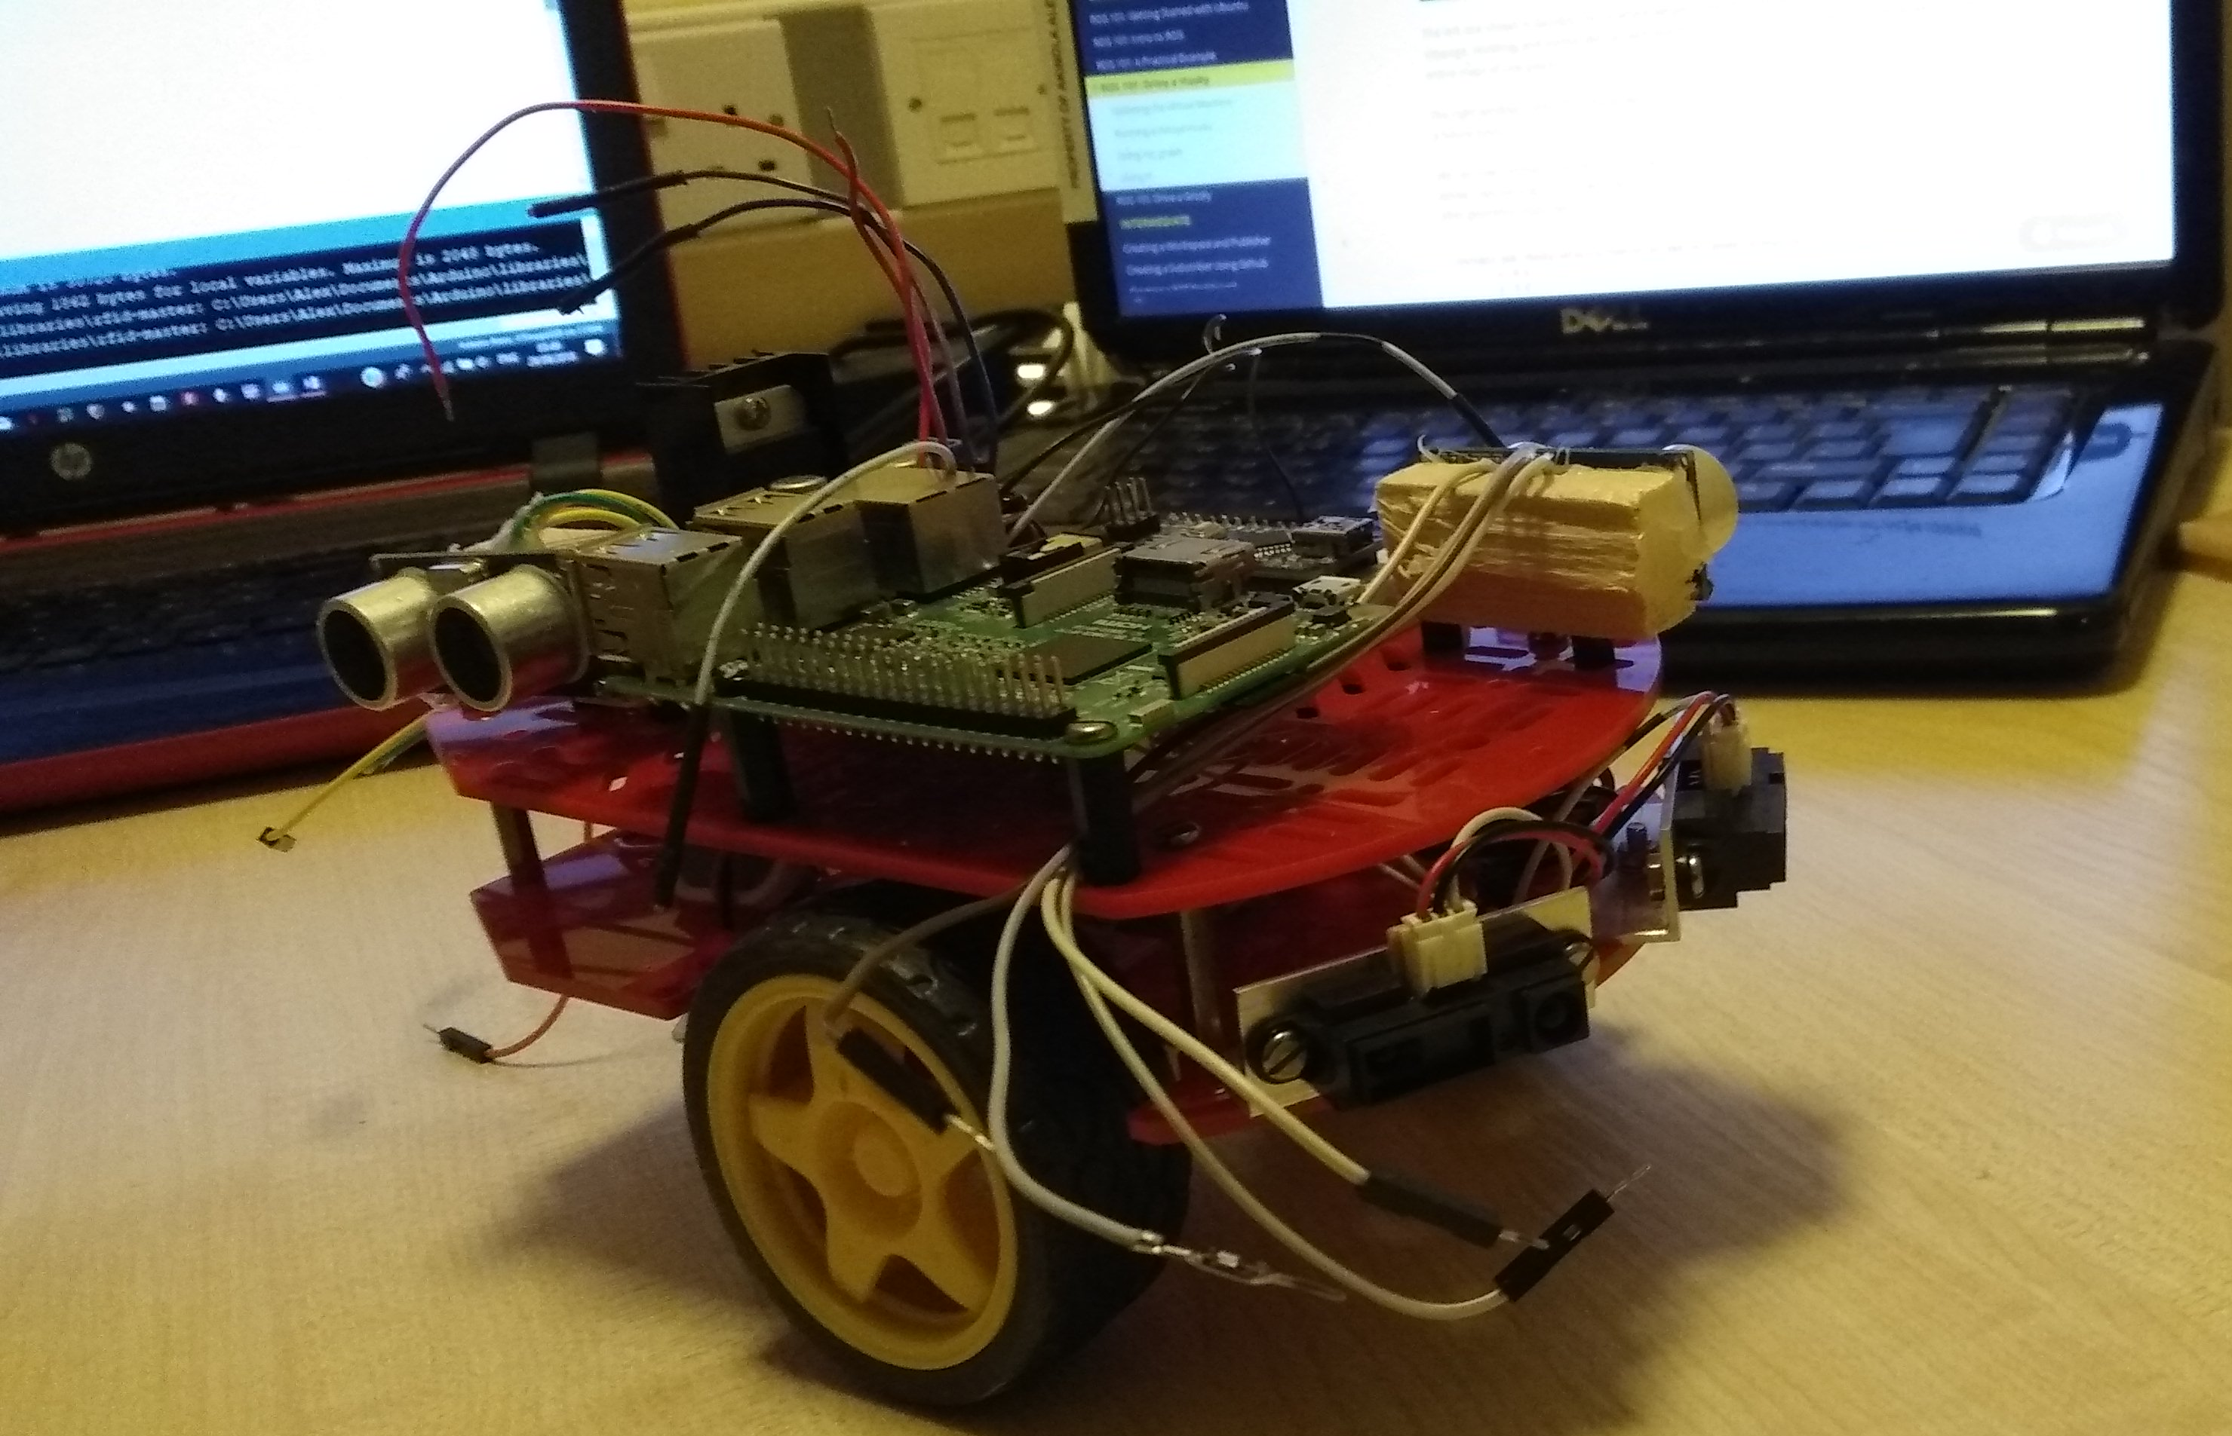
New Model

